Slide 1
Functions
Python Class #8
HEHology

Slide 2

Function
A block of code to perform an action

Slide 3
Function
Reusable
Organized
Single Action

Slide 4
Function
def print1to10():
for index in range(1,11):
print(index)
print1to10()
Note: def before usage

Slide 5
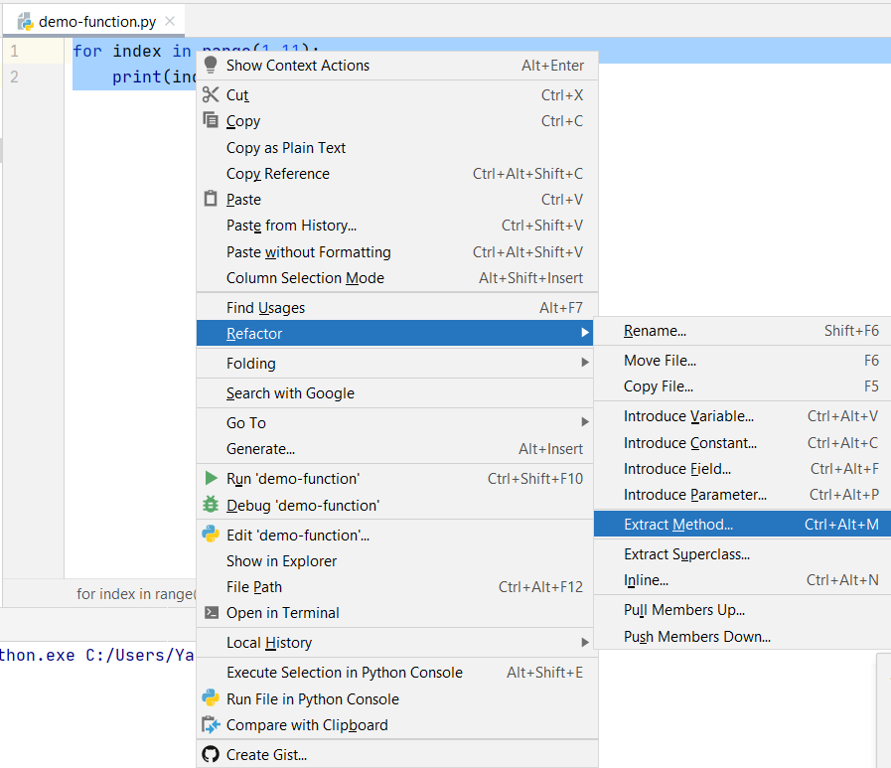
Refactor

Slide 6
int Methods
Methods
abs()
absolute value
n = abs(-100)
Exponents
pow()
print(pow(5,2))
**
print(5 ** 2)
max()
print(max(5, 10))
min()
sum()
a = (1, 2, 3, 4, 5)
print(sum(a))

Slide 7
str Methods
Methods
capitalize()
a = "oww"
print(a.capitalize())
Uppercase & Lowercase
upper()
lower()
len(string)
string = ‘Moooo’
print(len(string))
5
split()
text = 'hello world'
words = text.split(' ')
print(words)
startswith()
text = ‘hello world’
print(text.startswith(‘hello’))
https://www.w3schools.com/python/python_ref_string.asp

Slide 8

Thanks!
Any questions?
HEHology

